Slide 1
4.3
Logical Database Design

Slide 2
Normal Forms

Slide 3
Review: Database Design
Requirements Analysis
User needs; what must database do?
Conceptual Design
High level description (often done w/ER model)
Logical Design
Translate ER into DBMS(Relational) data model
Schema Refinement
Consistency, normalization
Physical Design - indexes, disk layout
Security Design - who accesses what

Slide 4
Refining an ER Diagram
1st diagram: Workers(S,N,L,D,Si) Departments(D,M,B)
Lots associated with workers.
Suppose all workers in a dep’t are assigned the same lot: D → L
Redundancy; fixed by: Workers2(S,N,D,Si) Dept_Lots(D,L) Departments(D,M,B)
Can fine-tune this: Workers2(S,N,D,Si) Departments(D,M,B,L)
Before:
since
name
dname
ssn
lot
did
budget
Employees
Works_In
Departments
After:
budget
since
name
dname
ssn
did
lot
Employees
Works_In
Departments

Slide 5
Definitions of Keys and Attributes Participating in Keys
A superkey of a relation schema R = {A₁, A₂, ...., A_{n}} is a set of attributes S subset-of R with the property that no two tuples t₁ and t₂ in any legal relation state r of R will have t₁[S] = t₂[S]
A key K is a superkey with the additional property that removal of any attribute from K will cause K not to be a superkey any more.

Slide 6
Definitions of Keys and Attributes Participating in Keys (2)
If a relation schema has more than one key, each is called a candidate key.
One of the candidate keys is arbitrarily designated to be the primary key, and the others are called secondary keys.
A Prime attribute
a member of some candidate key
A Nonprime attribute is not a prime attribute
it is not a member of any candidate key.

Slide 7
Normal Forms Based on Primary Keys
Normalization of Relations
Definitions of Keys and Attributes Participating in Keys
First Normal Form
Second Normal Form
Third Normal Form
Practical Use of Normal Forms

Slide 8
Normalization of Relations (1)
Normalization:
The process of decomposing unsatisfactory "bad" relations by breaking up their attributes into smaller relations
Normal form:
Condition using keys and FDs of a relation to certify whether a relation schema is in a particular normal form

Slide 9
Normalization of Relations (2)
2NF, 3NF, BCNF
based on keys and FDs of a relation schema
4NF
based on keys, multi-valued dependencies : MVDs;
5NF
based on keys, join dependencies : JDs
Additional properties may be needed to ensure a good relational design (lossless join, dependency preservation)

Slide 10
Normalization of Relations (3)
The practical utility of these normal forms becomes questionable when
the constraints on which they are based are hard to understand or to detect
Denormalization:
The process of storing the join of higher normal form relations as a base relation—which is in a lower normal form

Slide 11
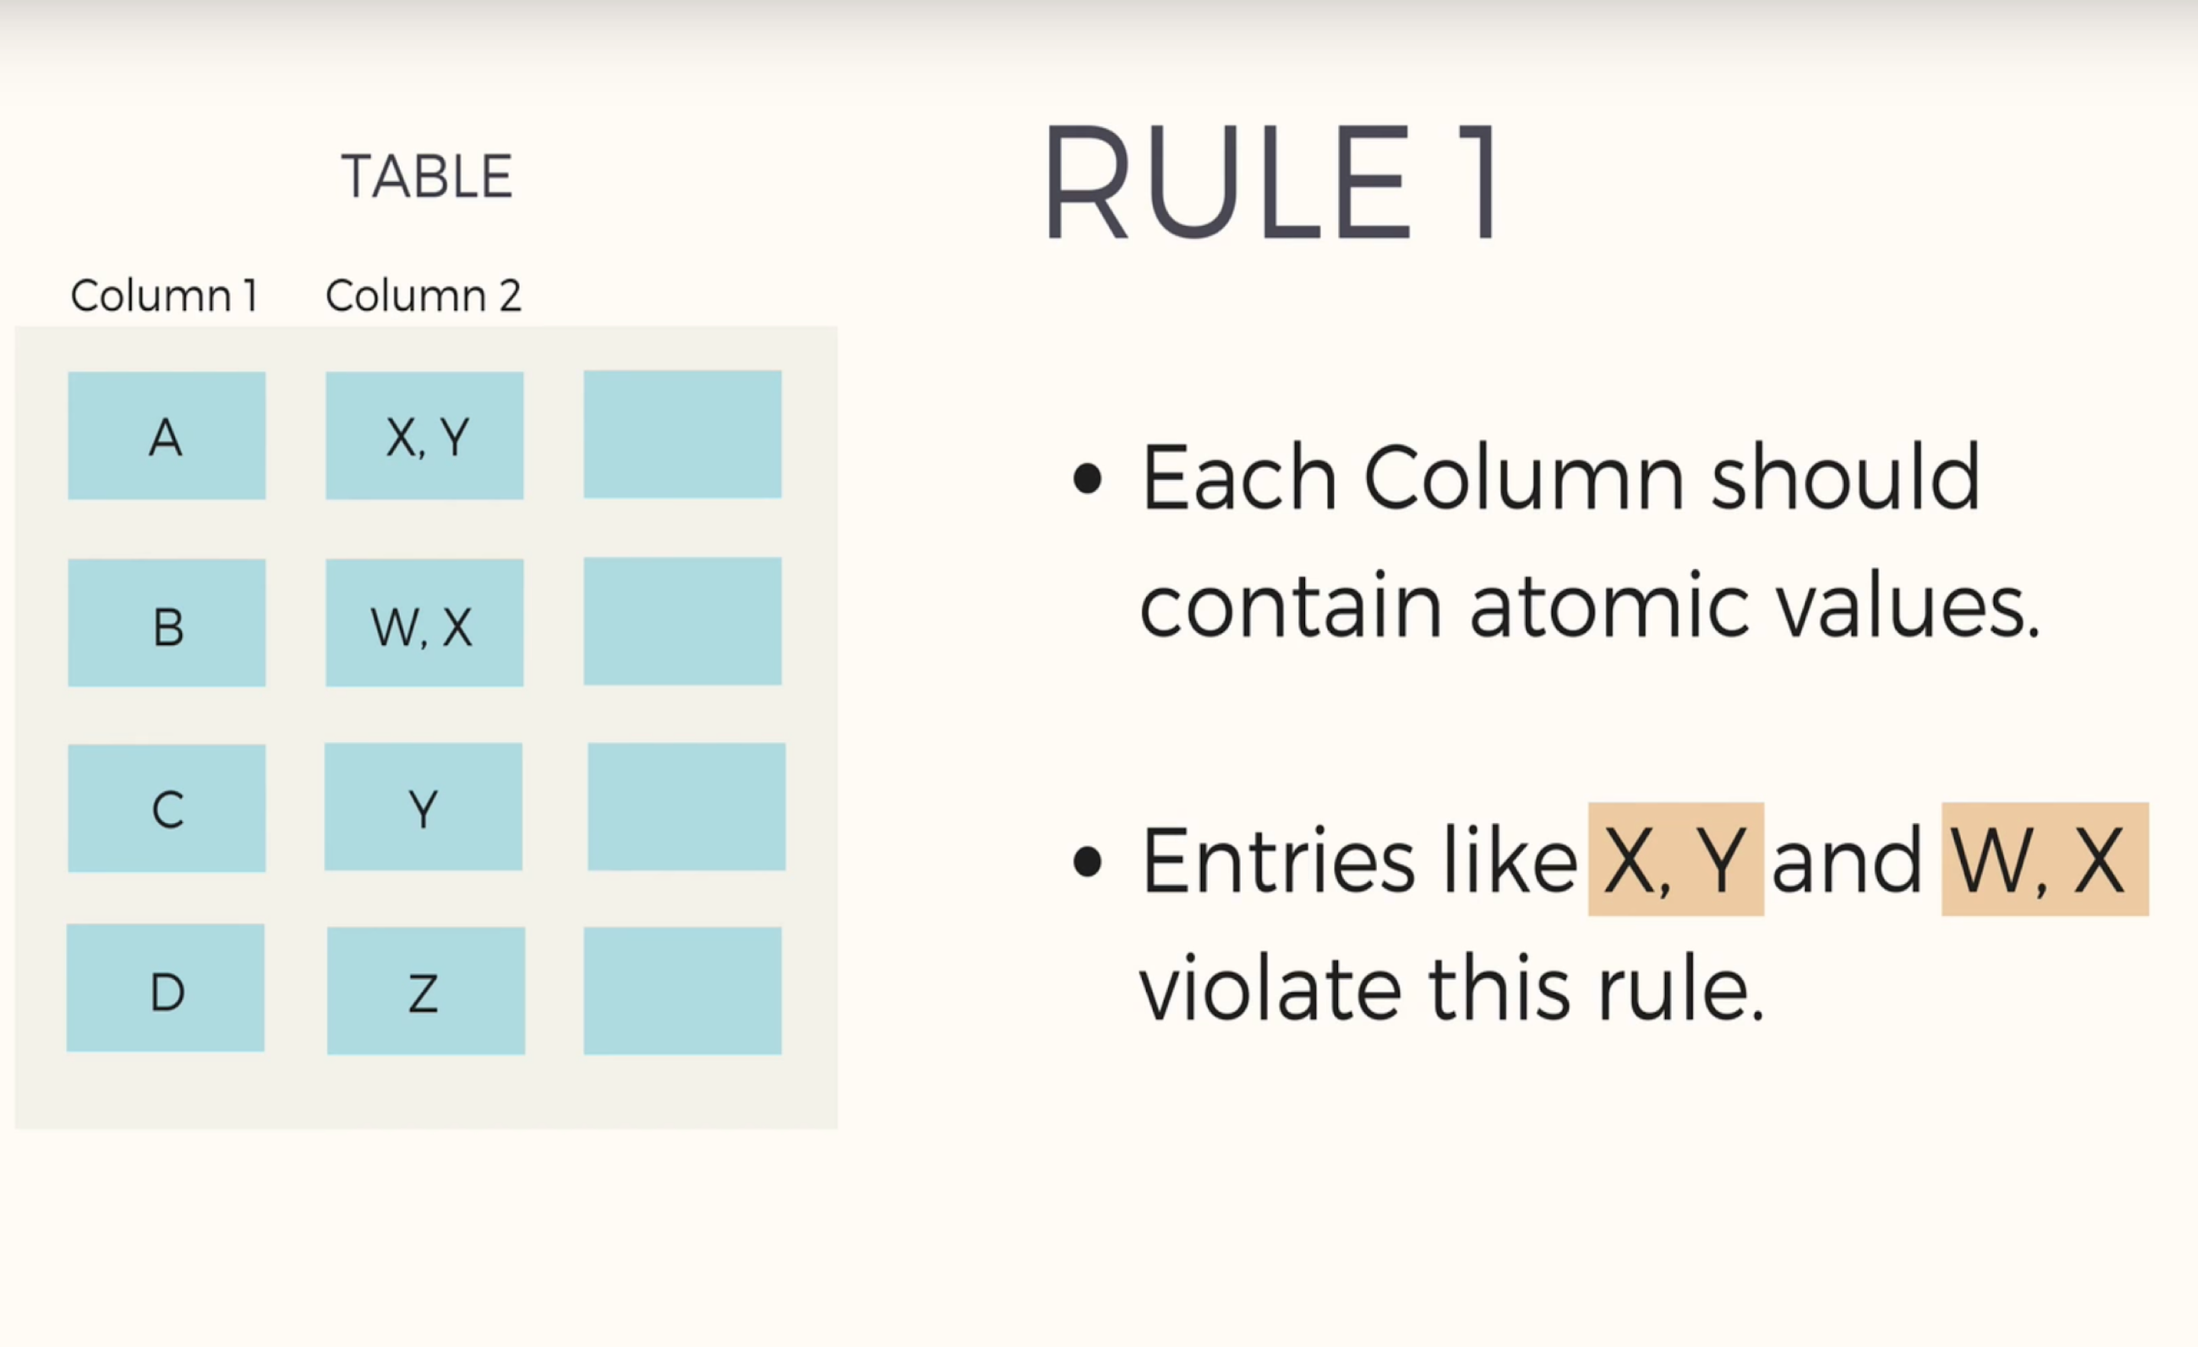
First Normal Form (1NF)
Notes:
These are called nested relations because each tuple can have a relation within it.

Slide 12
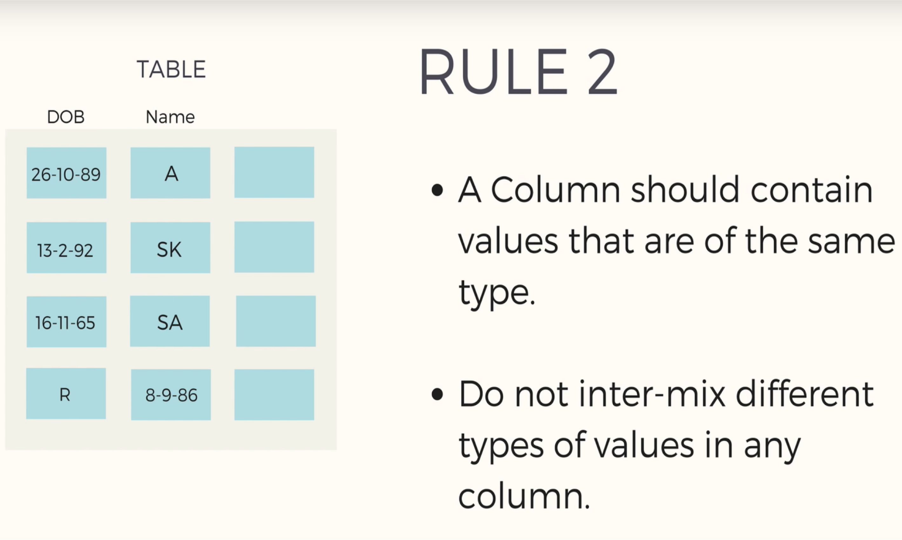
First Normal Form (1NF)
Notes:
These are called nested relations because each tuple can have a relation within it.

Slide 13
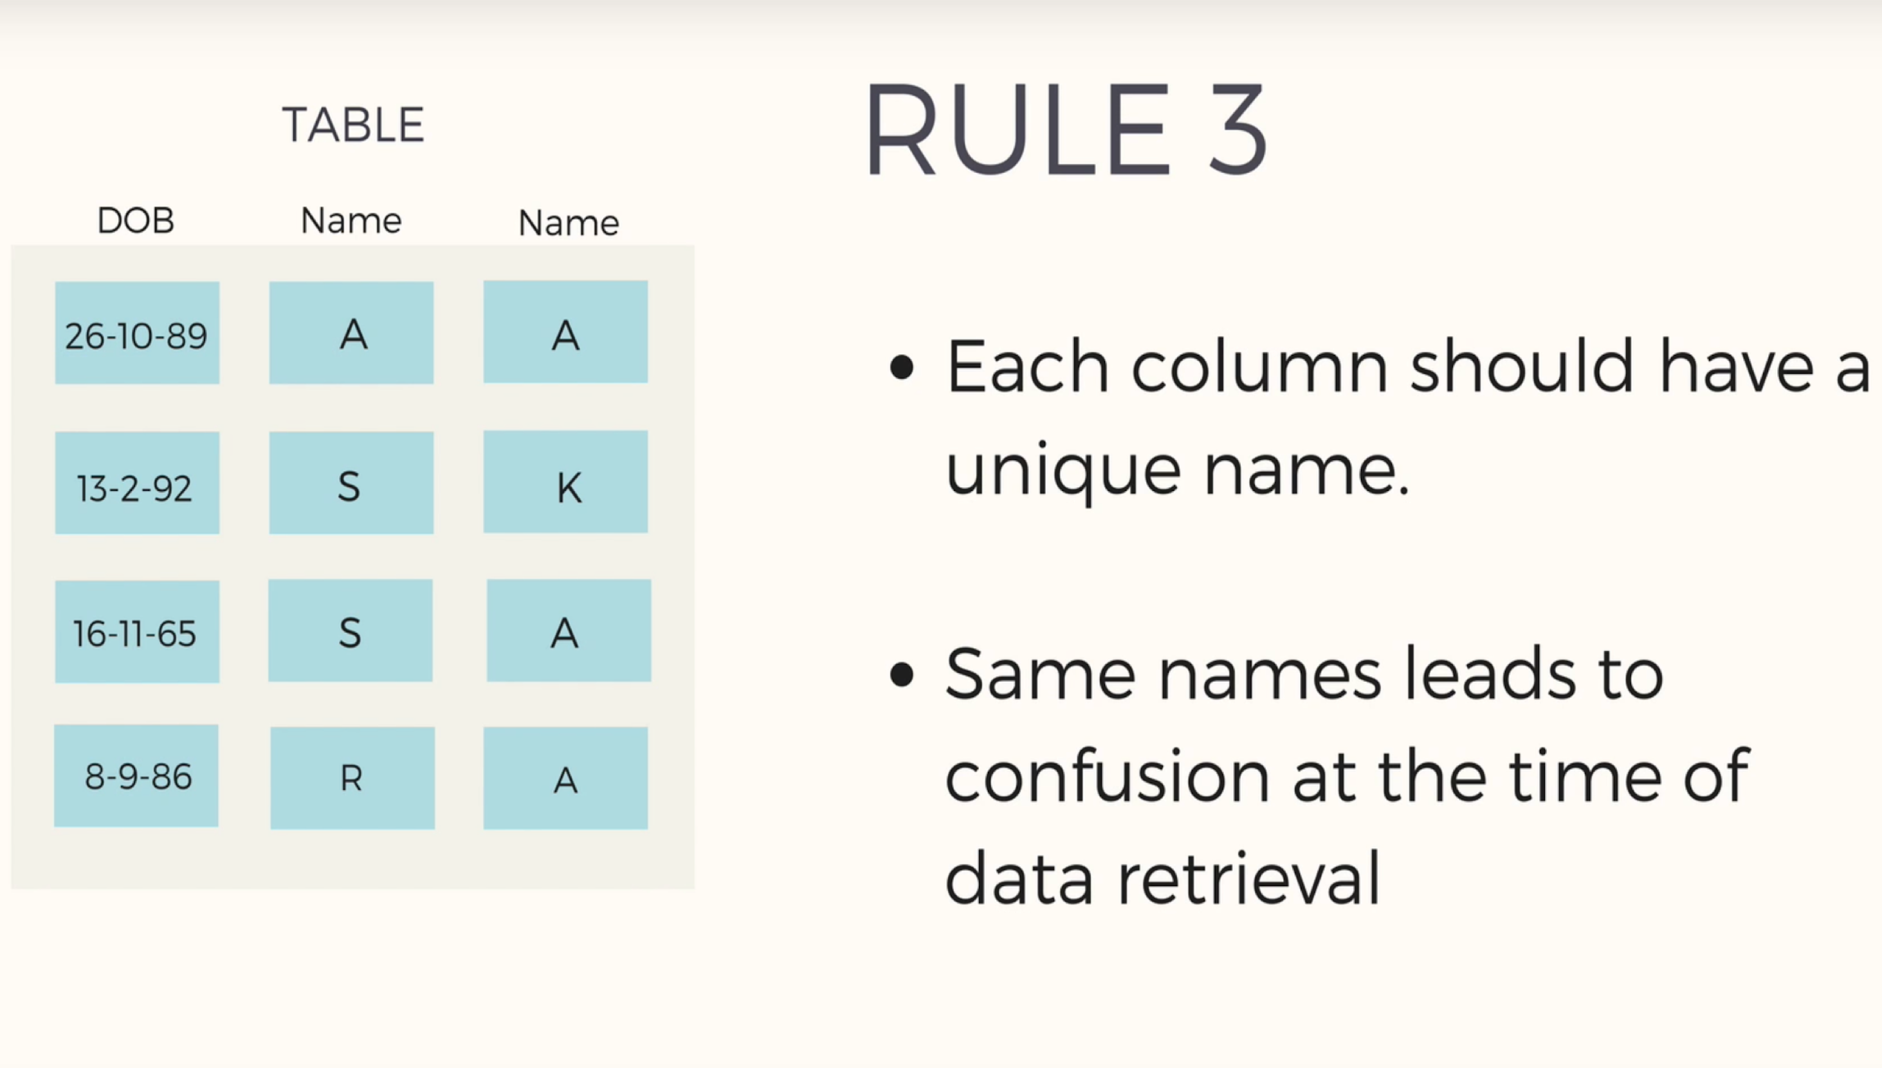
First Normal Form (1NF)
Notes:
These are called nested relations because each tuple can have a relation within it.

Slide 14
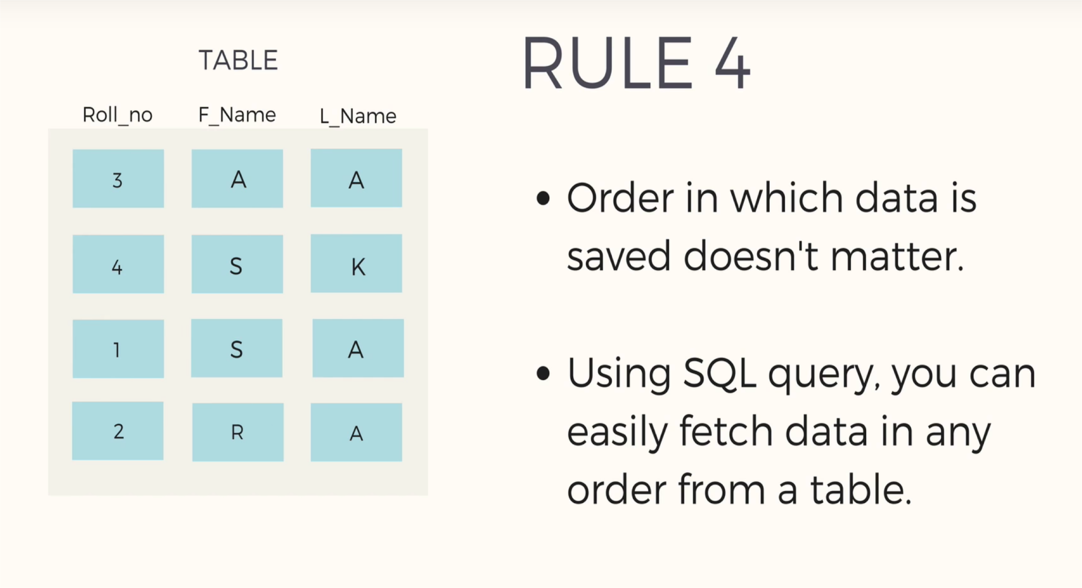
First Normal Form (1NF)
Notes:
These are called nested relations because each tuple can have a relation within it.

Slide 15
StudentID | First_Name | subject
456 | Abebe | OS, CN
789 | Mark | Java 2
102 | James | C, C++
301 | Steven | Python, Basic
456 | John | Econ, Physics
• Is this is 1NF?

Slide 16
StudentID | First_Name | Subject
456 | Abebe | OS
456 | Abebe | CN
789 | Mark | Java 2
102 | James | C
102 | James | C++
301 | Steven | Python
301 | Steven | Basic
456 | John | Econ
456 | John | Physics

Slide 17
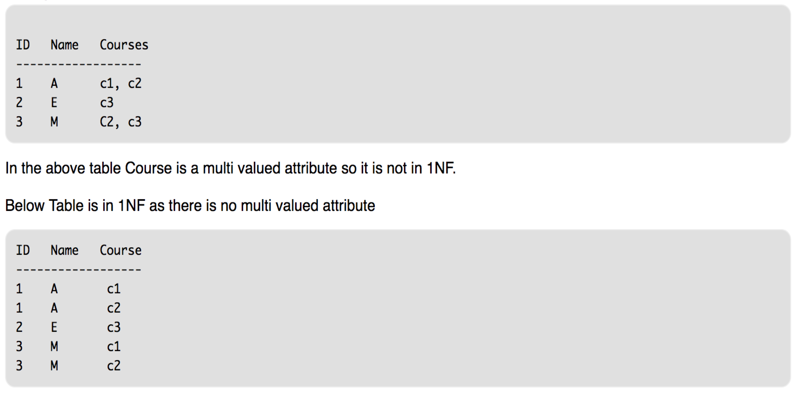

Slide 18

First Normal Form
Considered to be part of the definition of a relation
Most RDBMSs allow only those relations to be defined that are in First Normal Form
Disallows
Composite attributes
Multivalued attributes
Nested relations
attributes whose values for an individual tuple are non-atomic
multivalued attributes that are themselves composite.
Notes:
These are called nested relations because each tuple can have a relation within it.

Slide 19
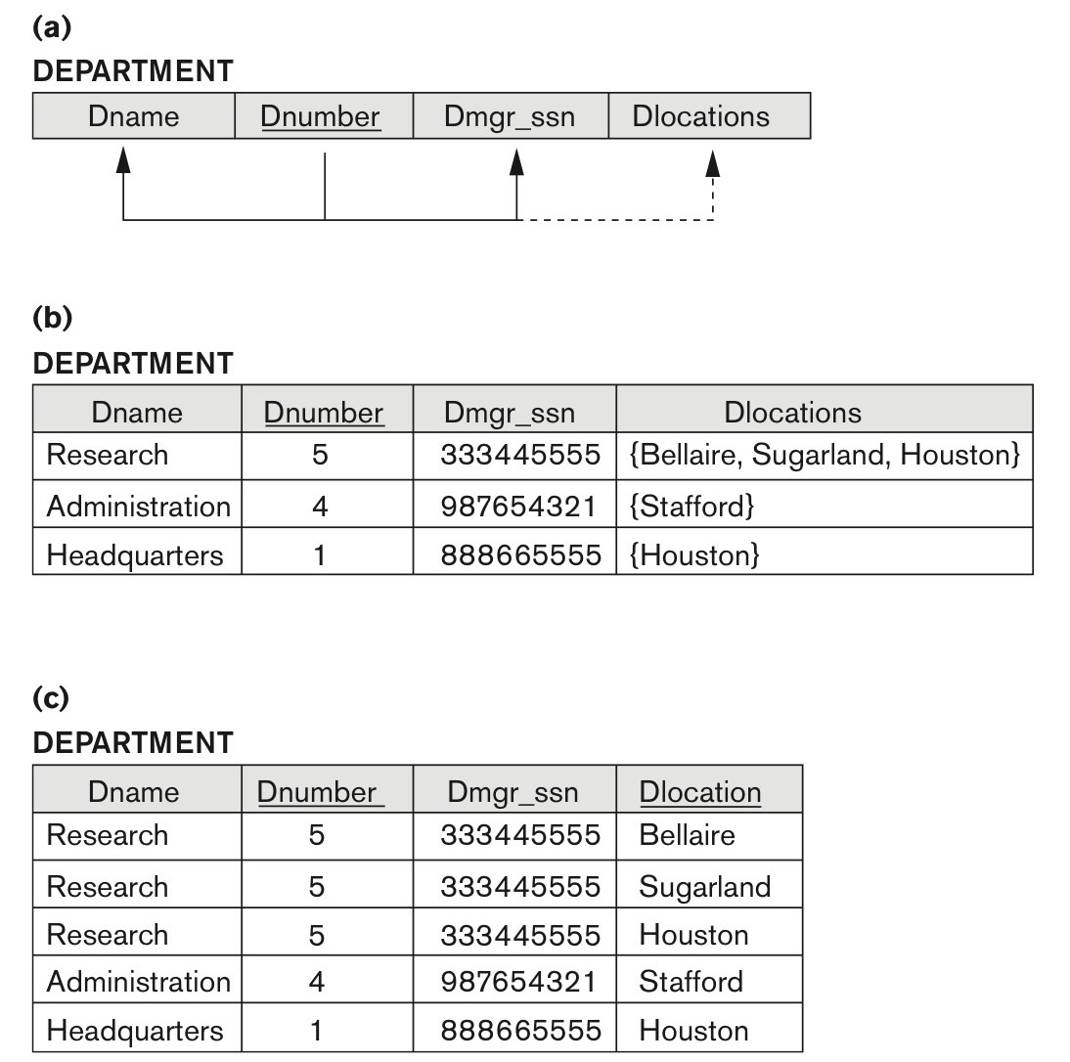
Normalization into 1NF
There are three main techniques to achieve 1NF for such a relation:
Remove the attribute Dlocations that violates 1NF and place it in a separate relation DEPT_LOCATIONS along with the primary key Dnumber of DEPARTMENT. The primary key of this newly formed relation is the combination {Dnumber, Dlocation}
Expand the key so that there will be a separate tuple in the original DEPARTMENT relation for each location of a DEPARTMENT.
In this case, the primary key becomes the combination {Dnumber, Dlocation}.
This solution has the disadvantage of introducing redundancy in the relation and hence is rarely adopted.
3. If it is known that at most three locations can exist for a department replace the Dlocations attribute by three atomic attributes: Dlocation1, Dlocation2, and Dlocation3.
Notes:
There are three main techniques to achieve first normal form for such a relation:
Remove the attribute Dlocations that violates 1NF and place it in a separate relation DEPT_LOCATIONS along with the primary key Dnumber of DEPARTMENT. The primary key of this newly formed relation is the combination {Dnumber, Dlocation}
Expand the key so that there will be a separate tuple in the original DEPARTMENT relation for each location of a DEPARTMENT, as shown in Figure 14.9(c). In this case, the primary key becomes the combination {Dnumber, Dlocation}. This solution has the disadvantage of introducing redundancy in the relation and hence is rarely adopted.
for example, if it is known that at most three locations can exist for a department
replace the Dlocations attribute by three atomic attributes: Dlocation1, Dlocation2, and Dlocation3.
This solution has the disadvantage of introducing NULL values if most departments have fewer than three locations.
It further introduces spurious semantics about the ordering among the location values; that ordering is not originally intended.
Querying on this attribute becomes more difficult; for example, consider how you would write the query: List the departments that have ‘Bellaire’ as one of their locations in this design. For all these reasons, it is best to avoid this alternative.

Slide 20
Normalization into 1NF
A relation schema that is not in 1NF.
Sample state of relation DEPARTMENT
1NF version of the same relation with redundancy.
Notes:
There are three main techniques to achieve first normal form for such a relation:
Remove the attribute Dlocations that violates 1NF and place it in a separate relation DEPT_LOCATIONS along with the primary key Dnumber of DEPARTMENT. The primary key of this newly formed relation is the combination {Dnumber, Dlocation}
Expand the key so that there will be a separate tuple in the original DEPARTMENT relation for each location of a DEPARTMENT, as shown in Figure 14.9(c). In this case, the primary key becomes the combination {Dnumber, Dlocation}. This solution has the disadvantage of introducing redundancy in the relation and hence is rarely adopted.
for example, if it is known that at most three locations can exist for a department
replace the Dlocations attribute by three atomic attributes: Dlocation1, Dlocation2, and Dlocation3.
This solution has the disadvantage of introducing NULL values if most departments have fewer than three locations.
It further introduces spurious semantics about the ordering among the location values; that ordering is not originally intended.
Querying on this attribute becomes more difficult; for example, consider how you would write the query: List the departments that have ‘Bellaire’ as one of their locations in this design. For all these reasons, it is best to avoid this alternative.

Slide 21
Normalization into 1NF
What about this?
Dname | Dnumber | Dmgr_ssn | Bellire | Sugarland | Houston | Stafford
Research | 5 | 333445555 | True | True | true
Administration | 4 | 987654321 |  |  |  | True
Headquarters | 1 | 8888665555 |  |  | true
Introduces NULL values.
It further introduces spurious semantics about the ordering among the location values; that ordering is not originally intended.
Querying on this attribute becomes more difficult;
for example, consider how you would write the query: List the departments that have ‘Bellaire’ as one of their locations in this design.
For all these reasons, it is best to avoid this alternative.
Notes:
if it is known that at most three locations can exist for a department
replace the Dlocations attribute by three atomic attributes: Dlocation1, Dlocation2, and Dlocation3.
This solution has the disadvantage of introducing NULL values if most departments have fewer than three locations.
It further introduces spurious semantics about the ordering among the location values; that ordering is not originally intended.
Querying on this attribute becomes more difficult; for example, consider how you would write the query: List the departments that have ‘Bellaire’ as one of their locations in this design. For all these reasons, it is best to avoid this alternative.

Slide 22
Normalization into 1NF
Of the three solutions above, the first is generally considered best because
it does not suffer from redundancy and it is completely general;
it places no maximum limit on the number of values.
In fact, if we choose the second solution, it will be decomposed further during subsequent normalization steps into the first solution.
Remove the attribute Dlocations that violates 1NF and place it in a separate relation DEPT_LOCATIONS along with the primary key Dnumber of DEPARTMENT.
The primary key of this newly formed relation is the combination {Dnumber, Dlocation}

Slide 23
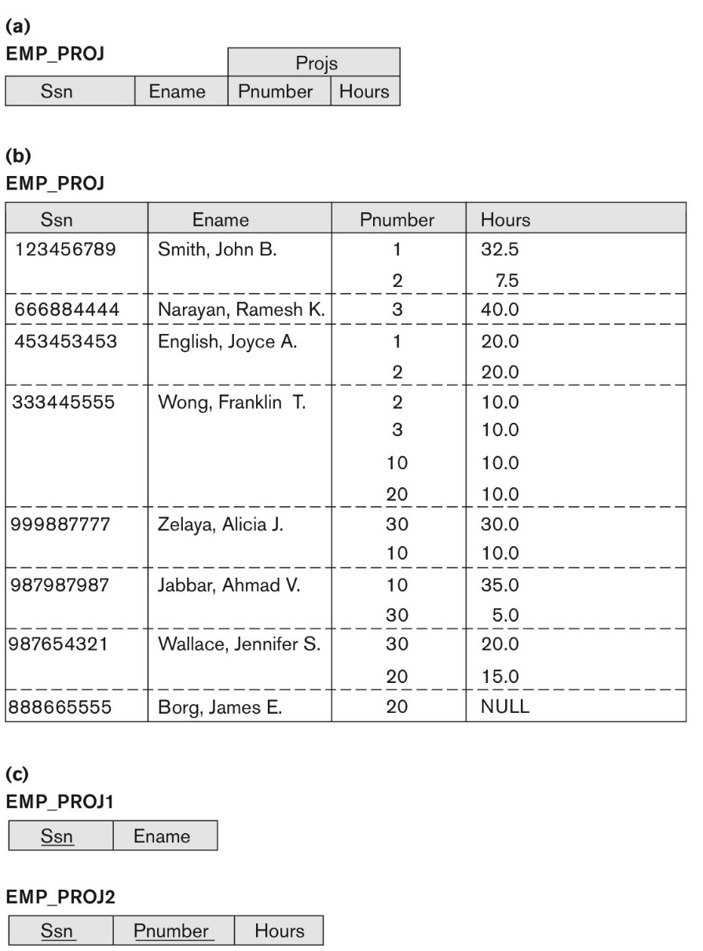
Normalizing nested relations into 1NF
Schema of the EMP_PROJ relation with a nested relation attribute PROJS
Sample extension of the EMP_PROJ relation showing nested relations within each tuple
1NF Version
Decomposition of EMP_PROJ into relations EMP_PROJ1 and EMP_PROJ2 by propagating the primary key.

Slide 24
Normalizing nested relations into 1NF
Schema of the EMP_PROJ relation with a nested relation attribute PROJS
EMP_PROJ(Ssn, Ename, {PROJS(Pnumber, Hours)})
EMP_PROJ1(Ssn, Ename)
EMP_PROJ2(Ssn, Pnumber, Hours)

Slide 25
Normalizing nested relations into 1NF
CANDIDATE (Ssn, Name, {JOB_HIST (Company, Highest_position, {SAL_HIST (Year, Max_sal)})})
CANDIDATE_1 (Ssn, Name)
CANDIDATE_JOB_HIST (Ssn, Company, Highest_position)
CANDIDATE_SAL_HIST (Ssn, Company, Year, Max-sal)

Slide 26
Normalizing nested relations into 1NF
The existence of more than one multivalued attribute in one relation must be handled carefully.
Example:
PERSON (Ss#, {Car_lic#}, {Phone#})
PERSON_IN_1NF (Ss#, Car_lic#, Phone#) (Redundancy)
This leads to the problems that are typically discovered at a later stage of normalization and that are handled by multivalued dependencies and 4NF
P1(Ss#, Car_lic#)
P2(Ss#, Phone#).

Slide 27
Exercise
Is the following relation in 1NF?
ID | Name | DepartmentID
ATR/8932/10 | Yonas Fiseha | EE
ATR/9127/10 | Leul Mengistu | CE
ATR/0382/10 | Natnael Getachew | ME
ATR/5845/10 | Samuel Teshome | CE
ATR/8157/10 | Nahom Sileshi | EE
No.
Name is not Atomic

Slide 28
FDs and Primary key
Definitions
Prime attribute: An attribute that is member of the primary key K
Full functional dependency: a FD Y -> Z where removal of any attribute from Y means the FD does not hold any more
Examples:
{SSN, PNUMBER} -> HOURS is a full FD since neither SSN -> HOURS nor PNUMBER -> HOURS hold
{SSN, PNUMBER} -> ENAME is not a full FD (it is called a partial dependency ) since SSN -> ENAME also holds

Slide 29
Second Normal Form (2NF)
The table should be in 1NF
There should be no partial dependency
Partial dependency: No non-prime attributes (i.e. fields that are not part of the candidate keys) is dependent on any proper subset of any candidate keys
If a relation has a composite key, all non-key attributes must depend on all of the components of the key

Slide 30
Second Normal Form (2NF)
Student_ID | Subject_ID | Marks | Teacher
10 | 1 | 70 | Java Teacher
10 | 2 | 75 | C++ Teacher
11 | 1 | 80 | Java Teacher
Functional Dependencies
FD1: {Student_ID, Subject_ID} → Marks Teacher
FD2: {Subject_ID} → Teacher
FD2 IS PARTIAL DEPENDENCY!!
Notes:
Teacher column only depends on subject and not the student – THIS IS PARTIAL DEPENDENCY!!

Slide 31
Second Normal Form (2NF)
Student_ID | Subject_ID | Marks
10 | 1 | 70
10 | 2 | 75
11 | 1 | 80
(2NF)
Subject_ID | Subject_Name | Teacher
1 | Java | Java Teacher
2 | C++ | C++ Teacher
3 | Php | Php Teacher

Slide 32
Second Normal Form (2NF)
ID | Date | CourseTitle | Seats | Room
SQL101 | 4/2/10 | Intro to SQL | 5 | 14
SQL101 | 5/4/10 | Intro to SQL | 2 | 9
SQL101 | 6/9/10 | Intro to SQL | 4 | 8
DB101 | 5/4/10 | Database Design | 6 | 11
ID | Date | Seats | Room
SQL101 | 4/2/10 | 5 | 14
SQL101 | 5/4/10 | 2 | 9
SQL101 | 6/9/10 | 4 | 8
DB101 | 5/4/10 | 6 | 11
ID | CourseTitle
SQL101 | Intro to SQL
DB 101 | Database Design

Slide 33
Second Normal Form
A relation schema R is in second normal form (2NF) if
every non-prime attribute A in R is fully functionally dependent on the primary key.
R can be decomposed into 2NF relations via the process of 2NF normalization or “second normalization”

Slide 34
Third Normal Form
According to Codd’s original definition, a relation schema R is in 3NF if it satisfies
2NF and
non-prime attribute of R is not transitively dependent on the primary key.

Slide 35
Transitive Functional Dependency
Definition:
Transitive functional dependency: a FD X -> Z that can be derived from two FDs X -> Y and Y -> Z
Examples:
SSN -> DMGRSSN is a transitive FD
Since SSN -> DNUMBER and DNUMBER -> DMGRSSN hold
SSN -> ENAME is non-transitive
Since there is no set of attributes X where SSN -> X and X -> ENAME

Slide 36
Transitive Functional Dependency
In X -> Y and Y -> Z, with X as the primary key, we consider this a problem only if Y is not a candidate key.
E.g., Consider EMP (SSN, Emp#, Salary ).
SSN → Emp#
Emp# → Salary
Here Emp# is a candidate key.
Notes:
When Y is a candidate key, there is no problem with the transitive dependency .

Slide 37
Third Normal Form
S_ID | S_NAME | COURSE | COUNTRY | S_CONTINENT
1 | ABEBE | DBMS | ETHIOPIA | AFRICA
2 | PIERE | OOP | FRANCE | EUROPE
3 | SURESH | OS | INDIA | ASIA
4 | KEBEDE | C++ | ETHIOPIA | AFRICA
S_ID | S_NAME | COURSE | S_COUNTRY
1 | ABEBE | DBMS | ETHIOPIA
2 | PIERE | OOP | FRANCE
3 | SURESH | OS | INDIA
S_COUNTRY | S_CONTINENT
ETHIOPIA | AFRICA
FRANCE | EUROPE
INDIA | ASIA

Slide 38
Normalizing into 2NF
EP
FD3
PNumber → PName PLocation
SSN | PNumber | Hours | EName | PName | PLocation
FD1
{SSN, PNumber}→ Hours
FD2
SSN → EName
Normalizing EP into 2NF relations
EP1
EP2
SSN | PNumber | Hours
SSN | EName
FD2
FD1
EP3
PNumber | PName | PLocation
FD3

Slide 39
Normalizing into 3NF
ED
SSN | EName | BDate | Address | DNumber | DName | DMgrSSN
FD1
SSN → EName BDate Address
FD2
DNumber → DName DMgrSSN
Normalizing ED into 3NF relations
ED1
SSN | EName | BDate | Address | DNumber
FD1
SSN → EName BDate Address
ED2
DNumber | DName | DMgrSSN
FD2
DNumber → DName DMgrSSN

Slide 40
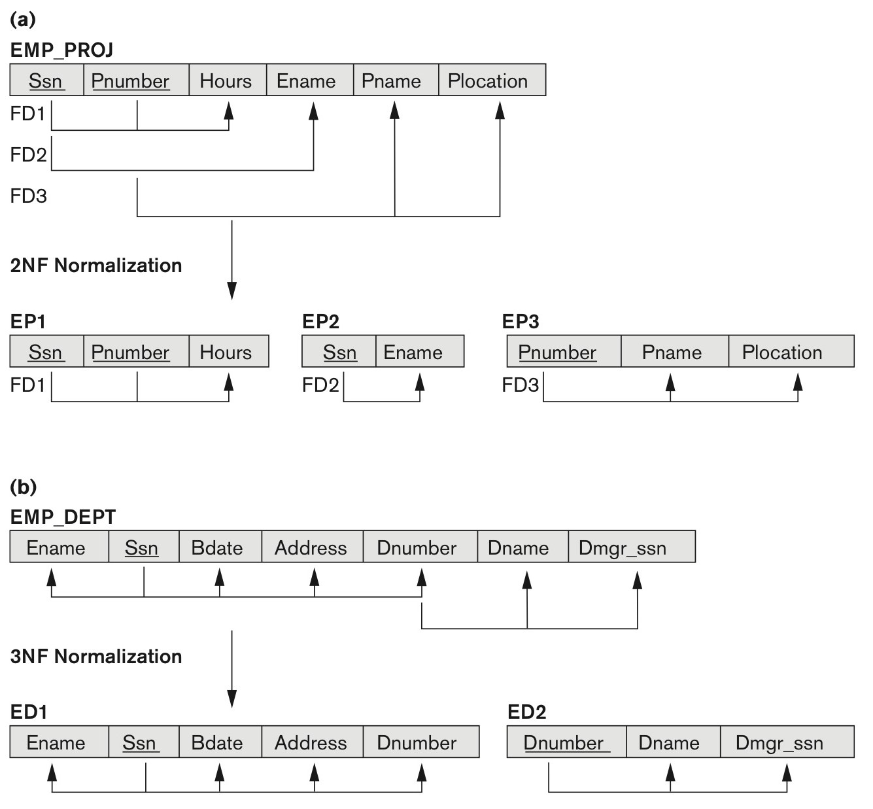
Normalizing into 2NF and 3NF
Partial Dependency.
{SSN, Pnumber}=key
SSN→ EName
Pnumber→ Pname
Normalizing EMP_PROJ into 2NF relations.
Transitive Dependency
SSN→ Dnumber
Dnumber➔Dname Dnumber➔Dmgr_SSN
Normalizing EMP_DEPT into 3NF relations.

Slide 41
Normal Forms Defined Informally
1st Normal form
All attributes depend on the key
2nd Normal form
All attributes depend on the whole key
3rd Normal form
All attributes depend on nothing but the key

Slide 42
General Normal Form Definitions (For Multiple Keys)
The above definitions consider the primary key only
The following more general definitions take into account relations with multiple candidate keys
Any attribute involved in a candidate key is a prime attribute
All other attributes are called non-prime attributes.

Slide 43
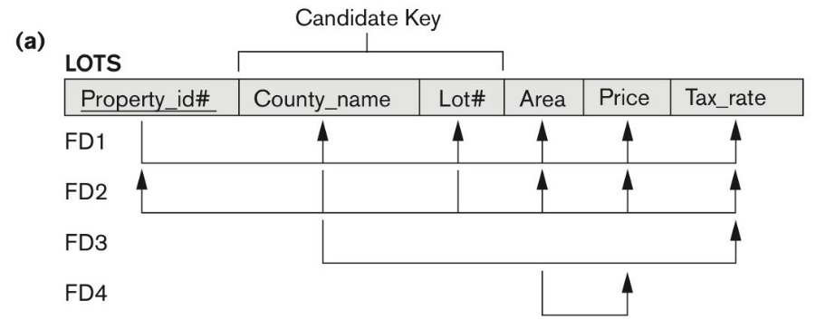
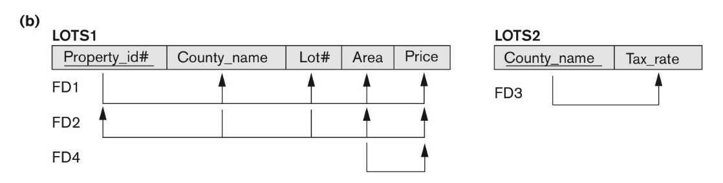
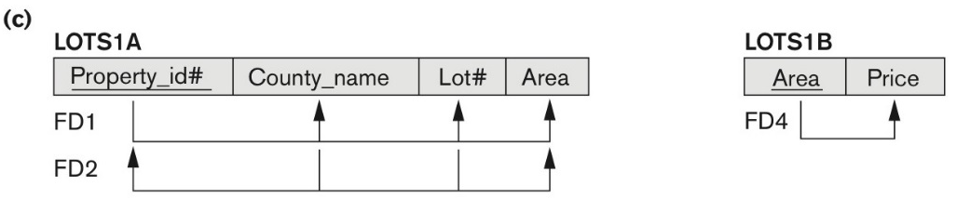
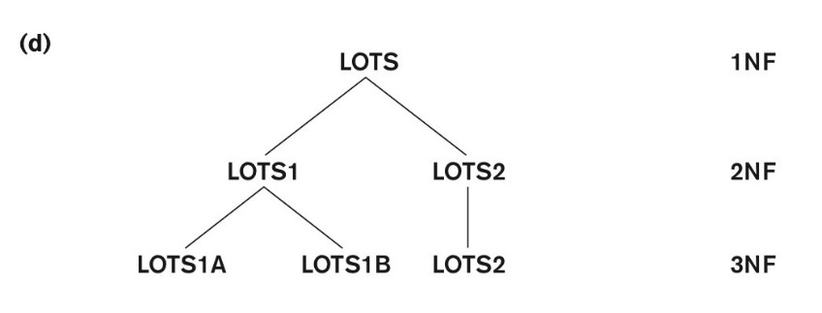
Normalization into 2NF and 3NF
(a) The LOTS relation with its functional dependencies FD1 through FD4.
(b) Decomposing into the 2NF relations LOTS1 and LOTS2.
(c) Decomposing LOTS1 into the 3NF relations LOTS1A and LOTS1B.
(d) Progressive normalization of LOTS into a 3NF design.

Slide 44
General Definition of 2NF (For Multiple Candidate Keys)
In previous slide the FD
County_name → Tax_rate violates 2NF.
So second normalization converts LOTS into
LOTS1 (Property_id#, County_name, Lot#, Area, Price)
LOTS2 ( County_name, Tax_rate)

Slide 45
General Definition of 2NF (For Multiple Candidate Keys)
A relation schema R is in second normal form (2NF) if
every non-prime attribute A in R is fully functionally dependent on every key of R.

Slide 46
Summary of Normal Forms Based on Primary Keys and Corresponding Normalization
Normal Form | Test | Remedy (Normalization)
First (1NF) | Relation should have no multivalued attributes or nested relations. | Form new relations for each multivalued attribute or nested relation.
Second (2NF) | For relations where primary key contains multiple attributes, no nonkey attribute should be functionally dependent on a part of the primary key. No partial dependency. | Decompose and set up a new relation for each partial key with its dependent attribute(s). Make sure to keep a relation with the original primary key and any attributes that are fully functionally dependent on it.
Third (3NF) | Relation should not have a non-key attribute functionally determined by another non-key attribute (or by a set of non-key attributes). That is, there should be no transitive dependency of a non-key attribute on the primary key. | Decompose and set up a relation that includes the non-key attribute(s) that functionally determine(s) other non-key attribute(s).

Slide 47
Normalization
FD3:
PNumber → PName PLocation
EP
SSN | PNumber | Hours | EName | PName | PLocation
FD | Dependency is
 | Partial
FD1 | NO
FD2 | YES
FD3 | YES
FD1:
{SSN, PNumber}→ Hours
FD2:
SSN → EName

Slide 48
Normalizing into 2NF
EP
FD3
PNumber → PName PLocation
SSN | PNumber | Hours | EName | PName | PLocation
FD1
{SSN, PNumber}→ Hours
FD2
SSN → EName
Normalizing EP into 2NF relations
EP1
EP2
SSN | PNumber | Hours
SSN | EName
FD2
FD1
EP3
PNumber | PName | PLocation
FD3

Slide 49
Normalization
DNumber → DName
DNumber → DMgrSSN
FD2:
ED
SSN | EName | BDate | Address | DNumber | DName | DMgrSSN
SSN → EName
SSN → BDate
SSN → Address SSN → DNumber
FD1:
Any Transitive Dependency
Between FD1 & FD2
SSN → DNumber → DMgrSSN

Slide 50
Normalizing into 3NF
ED
SSN | EName | BDate | Address | DNumber | DName | DMgrSSN
FD1
SSN → EName BDate Address
FD2
DNumber → DName DMgrSSN
Normalizing ED into 3NF relations
ED1
SSN | EName | BDate | Address | DNumber
FD1
SSN → EName BDate Address
ED2
DNumber | DName | DMgrSSN
FD2
DNumber → DName DMgrSSN

Slide 51
General Definition of Third Normal Form
Definition:
Superkey of relation schema R
a set of attributes S of R that contains a key of R
A relation schema R is in third normal form (3NF) if whenever a FD X → A holds in R, then either:
(a) X is a superkey of R, or
(b) A is a prime attribute of R

Slide 52
Normalization: 3NF
Candidate Key
FD (X → A) | FD1 | FD2 | FD4
X is a superkey of R | YES | YES | NO
A is a prime attribute of R | Don’t Care | Don’t Care | NO
FD4 (Area → Price) violates 3NF because Area is not a superkey.

Slide 53
Interpreting the General Definition of Third Normal Form
FD X → A
(a) X is a superkey of R, or
(b) A is a prime attribute of R
catches two types of violations :
one where a prime attribute functionally determines a non-prime attribute. This catches 2NF violations due to non-full functional dependencies.
second, where a non-prime attribute functionally determines a non-prime attribute. This catches 3NF violations due to a transitive dependency.

Slide 54
Interpreting the General Definition of Third Normal Form (2)
ALTERNATIVE DEFINITION of 3NF:
A relation schema R is in third normal form (3NF) if every non-prime attribute in R meets both of these conditions:
It is fully functionally dependent on every key of R
It is non-transitively dependent on every key of R
Note that stated this way, a relation in 3NF also meets the requirements for 2NF.

Slide 55
Normalization
FD X → A
(a) X is a superkey of R, or
(b) A is a prime attribute of R
The condition (b) is allowable to 3NF (“slip through” ) but not by BCNF which we discuss next.

Slide 56
Boyce-Codd Normal Form (BCNF)
Also known as 3.5NF
Tables must be in 3NF
Any dependency, A → B, A should be the Super key
i.e. there must be no dependency on non-prime attributes
FD: X → A
(a) X is a superkey of R, or
(b) A is a prime attribute of R

Slide 57
Boyce-Codd Normal Form (BCNF)
Any dependency, A → B, A should be the Super key
i.e. there must be no dependency on non-prime attributes
student_id | subject | professor
101 | Java | P.Java
101 | C++ | P.Cpp
102 | Java | P.Java2
103 | C# | P.Charp
104 | Java | P.Java
The table satisfies
1NF, 2NF, and 3NF but not BCNF
Dependency between professor → student

Slide 58
Boyce-Codd Normal Form (BCNF)
student_id | subject | professor
101 | Java | P.Java
101 | C++ | P.Cpp
102 | Java | P.Java2
103 | C# | P.Charp
104 | Java | P.Java
student_id | p_id
101 | 1
101 | 2
p_id | professor | subject
1 | P.Java | Java
2 | P.Cpp | C++

Slide 59
5. BCNF (Boyce-Codd Normal Form)
A relation schema R is in Boyce-Codd Normal Form (BCNF) if whenever an
FD X → A holds in R, then X is a superkey of R
Each normal form is strictly stronger than the previous one
Every 2NF relation is in 1NF
Every 3NF relation is in 2NF
Every BCNF relation is in 3NF
Hence BCNF is considered a stronger form of 3NF

Slide 60
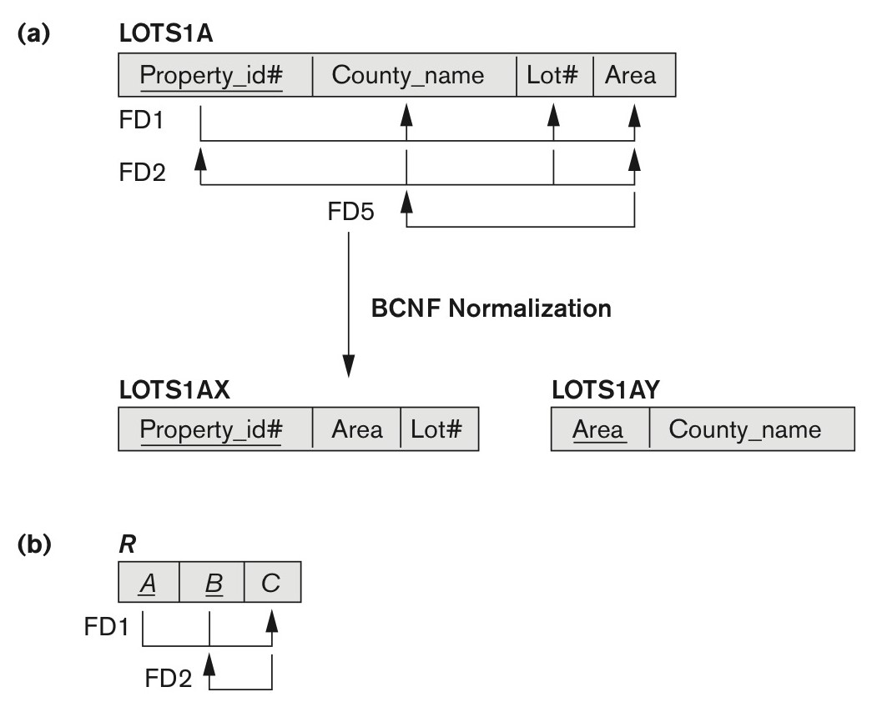
Boyce-Codd normal form
Is R in 3NF?
FD (X → A) | FD1 | FD2
X is a superkey of R | YES | NO
A is a prime attribute of R | X | YES
R is in 3NF
Is R in BCNF?
FD (X → A) | FD1 | FD2
X is a superkey of R | YES | NO
R is not in BCNF.
FD5 (C → B) violates BCNF because C is not a superkey.
Notes:
Suppose that we have thousands of lots in the relation but the lots are from only two counties: DeKalb and Fulton. Suppose also that lot sizes in DeKalb County are only 0.5, 0.6, 0.7, 0.8, 0.9, and 1.0 acres, whereas lot sizes in Fulton County restricted to 1.1, 1.2, ... , 1.9, and 2.0 acres.
In such a situation we would have the additional functional dependency FD5: Area→County_name. If we add this to the other dependencies, the relation schema LOTS1A still is in 3NF because this f.d. conforms to clause (b) in the general definition of 3NF, County_name being a prime attribute.

Slide 61
BCNF: Boyce-Codd Normal Form
Candidate Key
FD (X → A) | FD1 | FD2 | FD5
X is a superkey of R | YES | YES | NO
FD5 (Area → Country_name) violates 3NF because Area is not a superkey.
BCNF normalization of LOTS1A with the functional dependency FD2 being lost in the decomposition.
Notes:
Suppose that we have thousands of lots in the relation but the lots are from only two counties: DeKalb and Fulton. Suppose also that lot sizes in DeKalb County are only 0.5, 0.6, 0.7, 0.8, 0.9, and 1.0 acres, whereas lot sizes in Fulton County restricted to 1.1, 1.2, ... , 1.9, and 2.0 acres.
In such a situation we would have the additional functional dependency FD5: Area→County_name. If we add this to the other dependencies, the relation schema LOTS1A still is in 3NF because this f.d. conforms to clause (b) in the general definition of 3NF, County_name being a prime attribute.

Slide 62

Is relation TEACH 3NF or BCNF
TEACH
3NF – YES
BCNF - NO
fd1: {student, course} -> instructor
fd2: instructor -> course

Slide 63
Achieving the BCNF by Decomposition (1)
Two FDs exist in the relation TEACH:
fd1: { student, course} -> instructor
fd2: instructor -> course
{student, course} is a candidate key for this relation and that the dependencies shown follow the pattern in previous BCNF slide.
So this relation is in 3NF but not in BCNF
A relation NOT in BCNF should be decomposed so as to meet this property, while possibly forgoing the preservation of all functional dependencies in the decomposed relations.
(Read Algorithm 15.3 )

Slide 64
Test for checking non-additivity of Binary Relational Decompositions
Testing Binary Decompositions for Lossless Join (Non-additive Join) Property
Binary Decomposition: Decomposition of a relation R into two relations.
PROPERTY NJB (non-additive join test for binary decompositions):
A decomposition D = {R1, R2} of R has the lossless join property with respect to a set of functional dependencies F on R if and only if either
The f.d. ((R1 ∩ R2)  (R1- R2)) is in F⁺, or
The f.d. ((R1 ∩ R2)  (R2 - R1)) is in F⁺.

Slide 65
Achieving the BCNF by Decomposition
fd1: { student, course} -> instructor
fd2: instructor -> course
((R1 ∩ R2)  (R1- R2)) is in F⁺
((R1 ∩ R2)  (R2 - R1)) is in F⁺.
FD
Three possible decompositions for relation TEACH
TEACH(student, course, instructor)
D1: {student, instructor} and {student, course}
D2: {course, instructor } and {course, student}
D3: {instructor, course } and {instructor, student}
Notes:
Out of the above three, only the 3rd decomposition will not generate spurious tuples after join.(and hence has the non-additivity property).

Slide 66
Achieving the BCNF by Decomposition
fd1: { student, course} -> instructor
fd2: instructor -> course
((R1 ∩ R2)  (R1- R2)) is in F⁺
((R1 ∩ R2)  (R2 - R1)) is in F⁺.
FD
D1: {student, instructor} and {student, course}
R1 ∩ R2
R2 - R1
R1-R2
student
course
instructor
Student → course
Student → instructor
D2: {course, instructor } and {course, student}
D3: {instructor, course } and {instructor, student}
Notes:
Out of the above three, only the 3rd decomposition will not generate spurious tuples after join.(and hence has the non-additivity property).

Slide 67
Achieving the BCNF by Decomposition
fd1: { student, course} -> instructor
fd2: instructor -> course
((R1 ∩ R2)  (R1- R2)) is in F⁺
((R1 ∩ R2)  (R2 - R1)) is in F⁺.
FD
D1: {student, instructor} and {student, course}
D2: {course, instructor } and {course, student}
R1 ∩ R2
R2 - R1
R1-R2
course
student
instructor
course → student
course → instructor
D3: {instructor, course } and {instructor, student}
Notes:
Out of the above three, only the 3rd decomposition will not generate spurious tuples after join.(and hence has the non-additivity property).

Slide 68
Achieving the BCNF by Decomposition
fd1: { student, course} -> instructor
fd2: instructor -> course
((R1 ∩ R2)  (R1- R2)) is in F⁺
((R1 ∩ R2)  (R2 - R1)) is in F⁺.
FD
D1: {student, instructor} and {student, course}
D2: {course, instructor } and {course, student}
D3: {instructor, course } and {instructor, student}
R1 ∩ R2
R2 - R1
R1-R2
Instructor
course
student
course → student
course → instructor
D3: Passed NJB
Notes:
Out of the above three, only the 3rd decomposition will not generate spurious tuples after join.(and hence has the non-additivity property).

Slide 69
Achieving the BCNF by Decomposition
Three possible decompositions for relation TEACH
D1: {student, instructor} and {student, course}
D2: {course, instructor } and {course, student}
D3: {instructor, course } and {instructor, student} ✓
All three decompositions will lose fd1.
We have to settle for sacrificing the functional dependency preservation. But we cannot sacrifice the non-additivity property after decomposition.
Only the 3rd decomposition will not generate spurious tuples after join and hence has the non-additivity property.
Notes:
Out of the above three, only the 3rd decomposition will not generate spurious tuples after join.(and hence has the non-additivity property).

Slide 70
Test for checking non-additivity of Binary Relational Decompositions
If you apply the NJB test to the 3 decompositions of the TEACH relation:
D1 gives Student  Instructor or Student  Course, none of which is true.
D2 gives Course  Instructor or Course  Student, none of which is true.
However, in D3 we get Instructor  Course or Instructor  Student.
Since Instructor  Course is indeed true, the NJB property is satisfied and D3 is determined as a non-additive (good) decomposition.
Notes:
In the third decomposition, the R1∩R2 for the above testis Instructor and R1−R2 is Course. Because Instructor → Course, the NJB test is satisfied and the decomposition is nonadditive.

Slide 71
General Procedure for achieving BCNF when a relation fails BCNF (Algorithm 15.5)
Let R be the relation not in BCNF, let X be a subset-of R, and let X → A be the FD that causes a violation of BCNF. Then R may be decomposed into two relations:
(i) R –A and (ii) X υ A.
If either R –A or X υ A is not in BCNF, repeat the process.
Example
The f.d. that violated BCNF in TEACH was Instructor → Course.
Hence its BCNF decomposition would be :
(TEACH – COURSE) and (Instructor υ Course)
Which gives the relations:
(Instructor, Student) and (Instructor, Course)

Slide 72
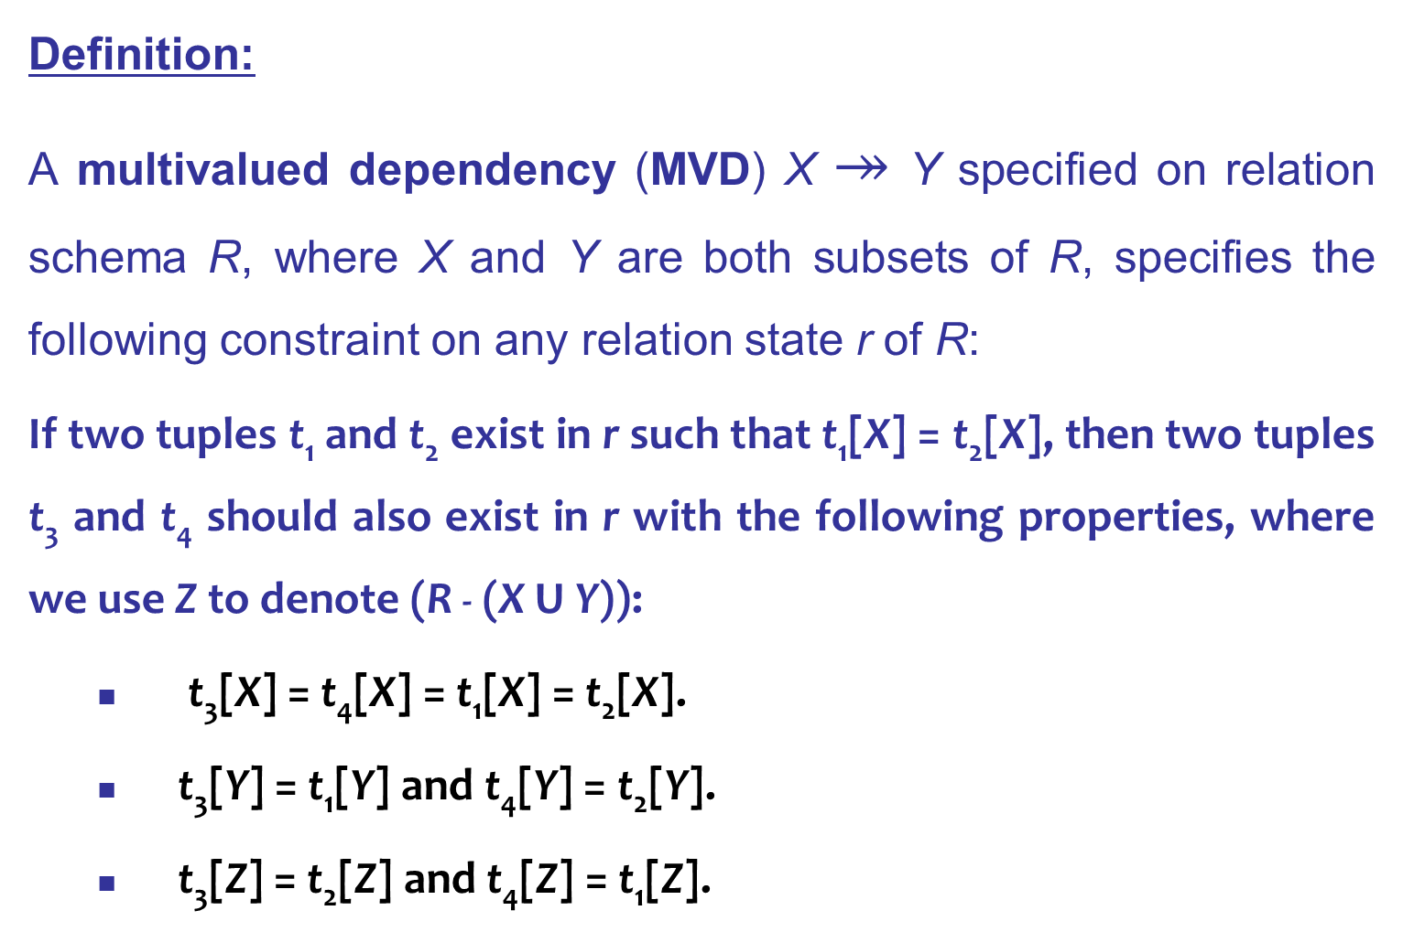
Multivalued Dependencies
Definition:
A multivalued dependency (MVD) X $↠$ Y specified on relation schema R, where X and Y are both subsets of R, specifies the following constraint on any relation state r of R:
If two tuples t₁ and t₂ exist in r such that t₁[X] = t₂[X], then two tuples t₃ and t₄ should also exist in r with the following properties, where we use Z to denote (R - (X U Y)):
t₃[X] = t₄[X] = t₁[X] = t₂[X].
t₃[Y] = t₁[Y] and t₄[Y] = t₂[Y].
t₃[Z] = t₂[Z] and t₄[Z] = t₁[Z].

Slide 73
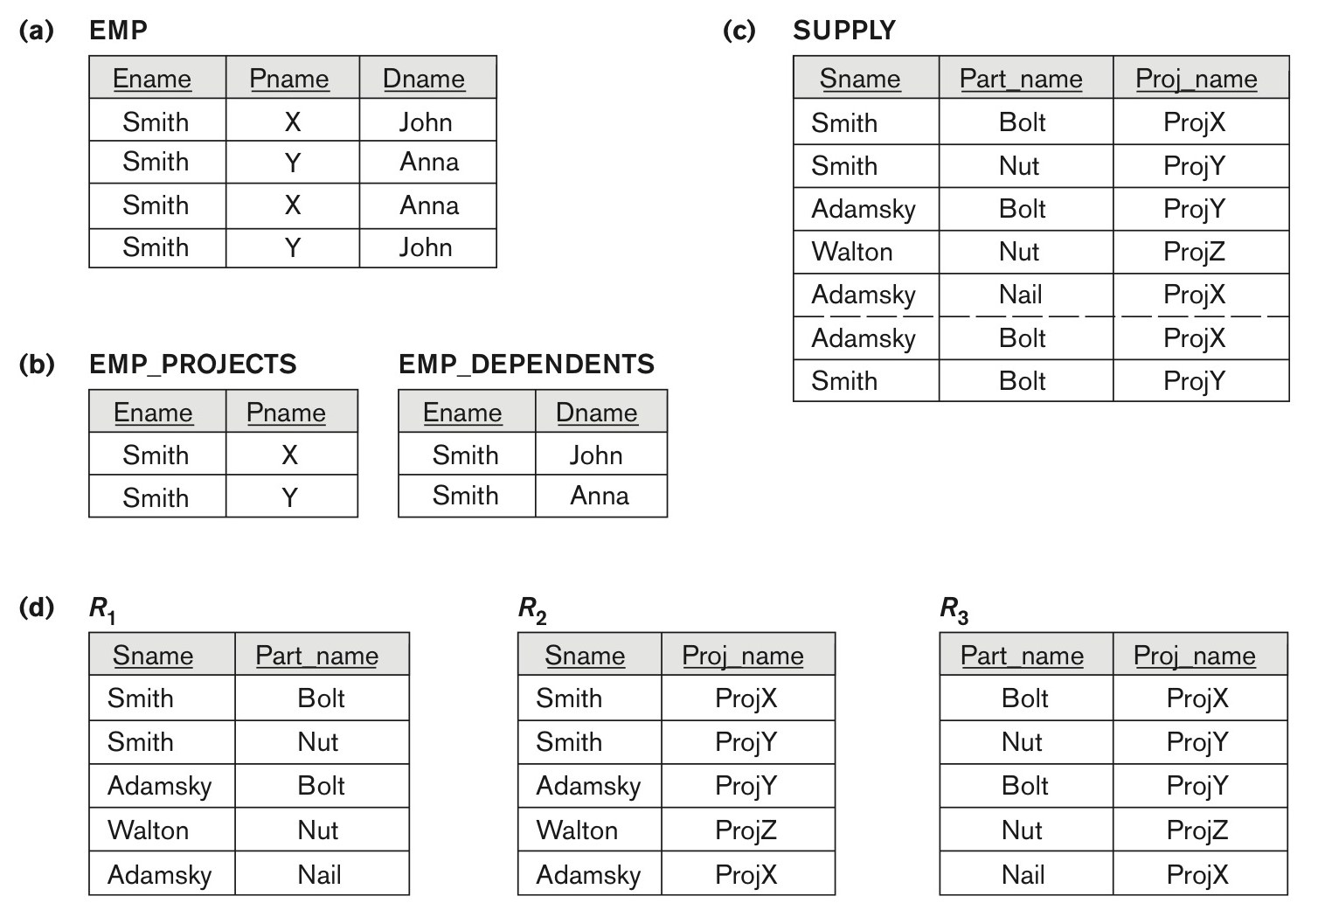
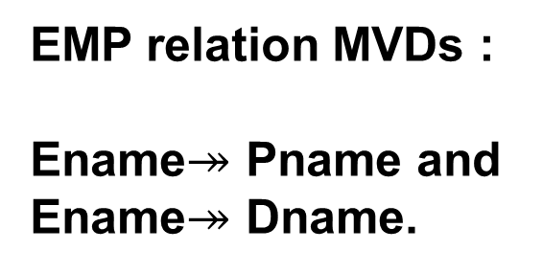
MVD: Multivalued Dependency
EMP
i
j
k
t₃[i] = t₄[i] = t₁[i] = t₂[i].
t₃[j] = t₁[j] and t₄[j] = t₂[j].
t₃[k] = t₂[k] and t₄[k] = t₁[k].
t₃[i] = t₄[i] = t₁[i] = t₂[i].
Smith
EMP relation MVDs :
Ename$↠$ Pname and
Ename$↠$ Dname.
t₃[j] = t₁[j] and t₄[j] = t₂[j]
X
Y
t₃[k] = t₂[k] and t₄[k] = t₁[k]
X
Y

Slide 74
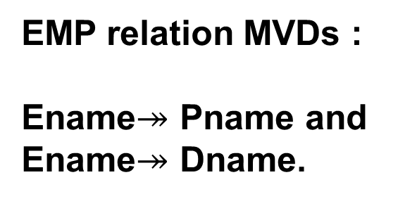
MVD: Multivalued Dependency
EMP relation MVDs :
Ename$↠$ Pname and
Ename$↠$ Dname.
4NF deals with MVDs

Slide 75
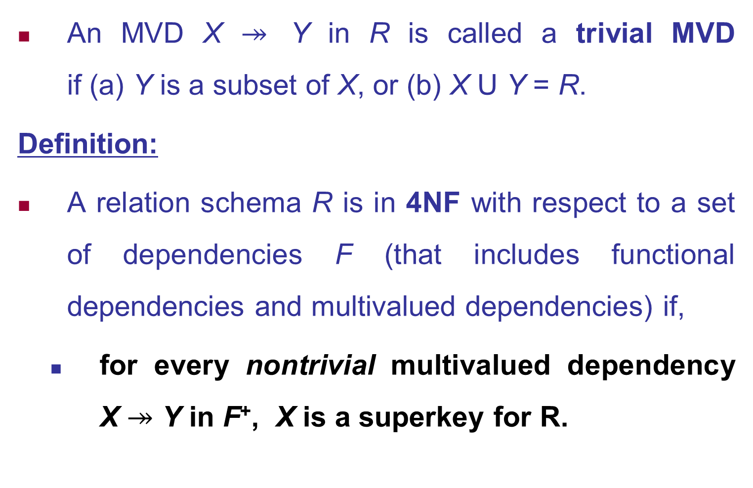
Fourth Normal Form (4NF)
An MVD X $↠$ Y in R is called a trivial MVD if (a) Y is a subset of X, or (b) X U Y = R.
Definition:
A relation schema R is in 4NF with respect to a set of dependencies F (that includes functional dependencies and multivalued dependencies) if,
for every nontrivial multivalued dependency X $↠$ Y in F⁺, X is a superkey for R.
Notes:
Note: F⁺ is the (complete) set of all dependencies (functional or multivalued) that will hold in every relation state r of R that satisfies F. It is also called the closure of F.

Slide 76
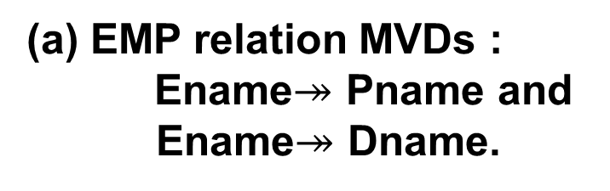
Fourth Normal Forms
(a) EMP relation MVDs :
Ename$↠$ Pname and
Ename$↠$ Dname.
Decomposing the EMP relation into two 4NF relations
EMP_PROJECTS and EMP_DEPENDENTS.

Slide 77
Join Dependencies
Definition:
A join dependency (JD), denoted by JD(R₁, R₂, ..., R_{n}), specified on relation schema R, specifies a constraint on the states r of R.
The constraint states that every legal state r of R should have a non-additive join decomposition into R₁, R₂, ..., R_{n}; that is, for every such r we have
* (π_{R1}(r), π_{R2}(r), ..., π_{Rn}(r)) = r
Note: an MVD is a special case of a JD where n = 2.
A join dependency is a trivial JD if one of the relation schemas R_{i} in JD(R₁, R₂, ..., R_{n}) is equal to R.
Notes:
A join dependency JD(R₁, R₂, ..., R_{n}), specified on relation schema R, is a trivial JD if one of the relation schemas R_{i} in JD(R₁, R₂, ..., R_{n}) is equal to R.

Slide 78
Fifth Normal Forms (5NF)
(c) The relation SUPPLY with no MVDs is in 4NF but not in 5NF if it has the JD(R1, R2, R3).
(d) Decomposing the relation SUPPLY into the 5NF relations R1, R2, R3.

Slide 79
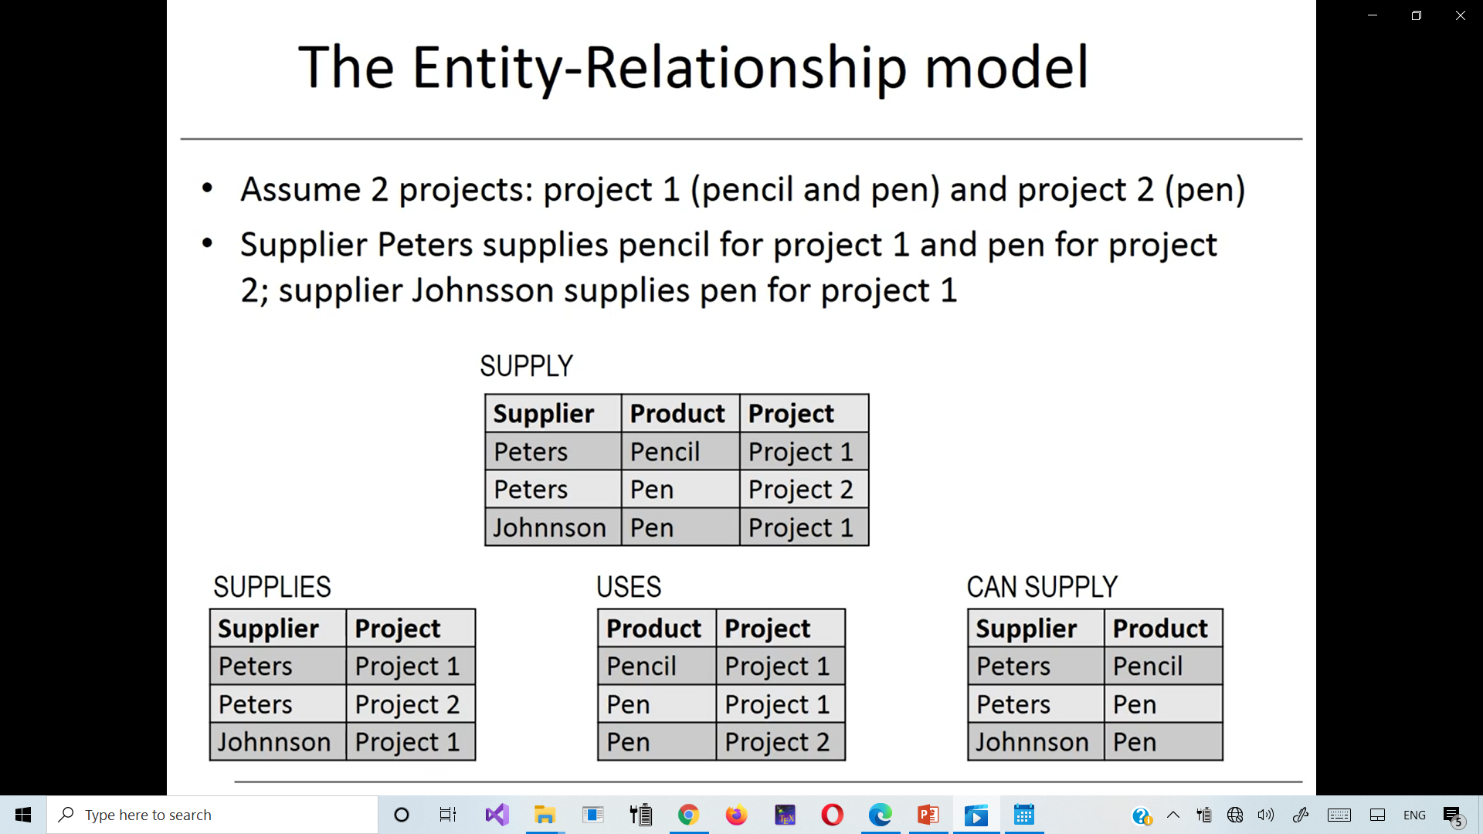
Before we look at 5NF
Before we look at 5NF
The SUPPLY Ternary Relationship.
SUPPLY
Three Binary Relationships.
Who supplied the pen to project 1

Slide 80
Fifth Normal Forms (5NF)
(c) The relation SUPPLY with no MVDs is in 4NF but not in 5NF if it has the JD(R1, R2, R3).
(d) Decomposing the relation SUPPLY into the 5NF relations R1, R2, R3.

Slide 81
Join Dependencies and Fifth Normal Form
Definition:
A relation schema R is in fifth normal form (5NF) (or Project-Join Normal Form (PJNF)) with respect to a set F of functional, multivalued, and join dependencies if,
for every nontrivial join dependency JD(R₁, R₂, ..., R_{n}) in F⁺ (that is, implied by F),
every R_{i} is a superkey of R.
Discovering join dependencies in practical databases with hundreds of relations is next to impossible.
Therefore, 5NF is rarely used in practice.

Slide 82
Practical Use of Normal Forms
Assuring that the designs are
good quality and
sustainable over long periods of time.
Reduces data redundancy and
Improves data integrity.
Notes:
Most practical design projects in commercial and governmental environment acquire existing designs of databases from previous designs, from designs in legacy models, or from existing files.

Slide 83
Practical Use of Normal Forms
Existing designs are evaluated by applying the tests for normal forms.
Another point worth noting is that the database designers need not normalize to the highest possible normal form.
Relations may be left in a lower normalization status, such as 2NF, for performance reasons. Doing so incurs the corresponding penalties of dealing with the anomalies.
Notes:
Most practical design projects in commercial and governmental environment acquire existing designs of databases from previous designs, from designs in legacy models, or from existing files.

Slide 84
Summary
Normal Forms (1NF, 2NF, 3NF) Based on Primary Keys
General Normal Form Definitions of 2NF and 3NF (For Multiple Keys)
BCNF (Boyce-Codd Normal Form)
Fourth and Fifth Normal Forms

Slide 85
Example
Find the highest normal form
R(A, B, C, D, E, F, G, H)
FD (ABC→DE, E→GH, H→G, G→H, ABCD→EF )
Key = ABCDEFGH
Key = ABC
Prime Attributes {A, B, C}
Non-Prime Attributes {D, E, F, G, H}
FD (X → A) | ABC→DE | E→GH | H→G | G→H | ABCD→EF
X is a superkey
A is a prime attribute
Partial Dependency
YES
NO
NO
NO
NO
NO
NO
NO
NO
NO
NO
NO
NO
NO
NO
BCNF
3NF
2NF
1NF
Notes:
E→GH

Slide 86
Example
Find the highest normal form
R(A, B, C, D)
FD (AB→CD, AC→BD, BC→D )
Key = ABCD
Key = AB
Prime Attributes {A, B}
Non-Prime Attributes {C,D}
Key = AB = AAC
Key = AC
Key = AC = AAB = AB
BCNF
3NF
2NF
1NF
Candidate Keys
AB, AC
Prime Attributes {A, B, C}
Non-Prime Attributes {D}
FD (X → A) | AB→CD | AC→BD | BC→D
X is a superkey
A is a prime attribute
Partial Dependency
YES
YES
NO
NO
NO
NO
NO
NO
YES
Notes:
E→GH

Slide 87
Exercises
Consider the relation R, which has attributes that hold schedules of courses and sections at a university;
R = {Course_no, Sec_no, Offering_dept, Credit_hours, Course_level, Instructor_ssn, Semester, Year, Days_hours, Room_no, No_of_students}.
Suppose that the following functional dependencies hold on R:
{Course_no}→{Offering_dept, Credit_hours, Course_level}
{Course_no, Sec_no, Semester, Year}→{Days_hours, Room_no,No_of_students, Instructor_ssn}
{Room_no, Days_hours, Semester, Year}→{Instructor_ssn, Course_no, Sec_no}
Try to determine which sets of attributes form keys of R. How would you normalize this relation?

Slide 88
Exercises
Consider the following relation for published books:
BOOK (Book_title, Author_name, Book_type, List_price, Author_affil, Publisher)
Author_affil refers to the affiliation of author.
Suppose the following dependencies exist:
Book_title→Publisher, Book_type
Book_type→List_price
Author_name→Author_affil
What normal form is the relation in? Explain your answer.
Apply normalization until you cannot decompose the relations further. State the reasons behind each decomposition

Slide 89
Exercises
Consider the following relation:
CAR_SALE(Car#, Date_sold, Salesperson#, Commission%, Discount_amt)
Assume that a car may be sold by multiple salespeople, and hence {Car#, Salesperson#} is the primary key. Additional dependencies are:
Date_sold→Discount_amt
andSalesperson#→Commission%
Based on the given primary key, is this relation in 1NF, 2NF, or 3NF? Why or why not?
How would you successively normalize it completely?

Slide 90
Exercises
Consider the following relations for an order-processing application data-base at ABC, Inc.
ORDER (O#, Odate, Cust#, Total_amount)
ORDER_ITEM(O#, I#, Qty_ordered, Total_price, Discount%)
Assume that each item has a different discount. The Total_price refers to one item, Odate is the date on which the order was placed, and the Total_amountis the amount of the order.
If we apply a natural join on the relations ORDER_ITEM and ORDER in this database, what does the resulting relation schema RES look like?
What will be its key? Show the FDs in this resulting relation.
Is RES in 2NF? Is it in 3NF? Why or why not? State assumptions, if you make any.

Slide 91
Exercises
Consider the following relation that refers to business trips made by company sales people :
TRIP (Trip_id, Start_date, Cities_visited, Cards_used)
Suppose the TRIP has a single Start_date but involves many Cities and sales people may use multiple credit cards on the trip.
Make up a mock-up population of the table.
Discuss what FDs and/or MVDs exist in this relation.
Show how you will go about normalizing the relation.

Slide 92
Exercises
Consider the following relation (options installed in cars e.g., cruise control) that were sold at a dealership:
CAR_SALE (Car_id, Option_type, Option_listprice, Sale_date,Option_discountedprice)
Functional Dependencies:
CarID → Sale_date
Option_type → Option_listprice
{CarID, Option_type}→ Option_discountedprice
Argue using the generalized definition of the 3NF that this relation is not in 3NF. Then argue from your knowledge of 2NF, why it is not even in 2NF.

Slide 93
Exercises
Consider the following relation:
R (Doctor#, Patient#, Date, Diagnosis, Treat_code, Charge)
In the above relation, a tuple describes a visit of a patient to a doctor along with a treatment code and daily charge.
Assume that diagnosis is determined (uniquely) for each patient by a doctor.
Assume that each treatment code has a fixed charge (regardless of patient).
Is this relation in 2NF?
Justify your answer and decompose if necessary.
Then argue whether further normalization to 3NF is necessary, and if so, perform it.

Slide 94
Exercises
Consider the following relation:
A | B | C | TUPLE#
10 | b1 | C1 | 1
10 | B2 | C2 | 2
11 | B4 | C1 | 3
12 | B3 | C4 | 4
13 | B1 | C1 | 5
14 | b3 | C4 | 6
Does this relation have a potential candidate key? If it does, what is it? If it does not, why not?
Which of the following dependencies may hold in the above relation? If the dependency cannot hold, explain why by specifying the tuples that cause the violation. i. A → B, ii. B → C, iii. C → B, iv. B → A, v. C → A

Slide 95
Exercises
Consider the universal relation R = {A, B, C, D, E, F, G, H, I, J} and the set of functional dependencies F = {{A, B}→{C}, {A}→{D, E}, {B}→{F}, {F}→{G, H}, {D}→{I, J}}. What is the key for R? Decompose R into 2NF and then 3NF relations.
Repeat it for the following different set of functional dependencies G= {{A, B}→{C}, {B, D}→{E, F}, {A, D}→{G, H}, {A}→{I}, {H}→{J}}.

Slide 96
Exercises
Consider a relation R(A, B, C, D, E) with the following dependencies:
AB → C, CD → E, DE → B
Is AB a candidate key of this relation?
If not, is ABD? Explain your answer.

Slide 97
QUIZ: Find the highest normal form
R(A,B,C) FD(A→B, B→AC) CK: A, B
R(A,B,C, D) FD(A→BCD, BC→AD, D→B) CK: A, BC, CD
R(A,B,C, D) FD(AB→C, ABD→C, ABC→D, AC →D) CK: AB
R(A,B,C, D,E) FD(AE→BC, AC→D, CD→BE, D→E) CK: AD, AC, AE
R(A,B,C, D,E) FD(AB→CDE, D→BE) CK: AB, AD

